Slide 1
Cognos 8 Framework Manager
Notes:
This slide shows the Table of Contents. They are
- About Framework Manager
-Planning your metadata
- Objects you will work with
- Projects
- Packages
- Guideline for modeling metadata
- Hands-on in Framework Manager
HCU EABIS
Cognos Competency

Slide 2
Topics:
About Framework Manager
Planning your metadata
Objects you will work with
Projects
Packages
Guideline for modeling metadata
Hands-on in Framework Manager
Notes:
This slide shows the Table of Contents. They are
- About Framework Manager
-Planning your metadata
- Objects you will work with
- Projects
- Packages
- Guideline for modeling metadata
- Hands-on in Framework Manager
HCU EABIS
Cognos Competency

Slide 3
About Framework Manager:
What is Framework Manager?
Framework Manager provides the metadata relational and dimensional model for Business.
Use Framework Manager to model the business presentation of data derived from one or more data sources.
Notes:
It provides:
Metadata development environment for Cognos Reporting
Modeling the presentation of data derived from one or more data sources
HCU EABIS
Cognos Competency

Slide 4
Planning your Metadata:
Do you and the report authors agree on the reporting requirements?
Does the data source contain the data and metadata that you need?
Does the same data exist in more than one source?
Which data source tables are the fact tables, which are the dimensions, and which are both fact table and dimension?
What are the keys and attributes of each dimension?
Which relationships are required?
Do any required tables contain embedded dimension information other than foreign keys?
Are there multiple relationship paths between tables?
Notes:
This slide helps us with how we go about with planning of metadata. Primarily , the questions that we need to answer before we plan are:
- Do you and the report authors agree on the reporting requirements?
- Does the data source contain the data and metadata that you need?
- Does the same data exist in more than one source?
- Which data source tables are the fact tables, which are the dimensions, and which are both fact table and dimension?
- What are the keys and attributes of each dimension?
- Which relationships are required?
- Do any required tables contain embedded dimension information other than foreign keys?
- Are there multiple relationship paths between tables?
HCU EABIS
Cognos Competency

Slide 5
Objects you will work with:
In a Framework Manager project, you will interact with the following objects:
  model
  namespace
  folder
  query subject
  query item
  relationship
  parameter map
  package
Notes:
This slide shows the various objects we would interact with in the due course of creating a project using Framework Manager. The objects are:
- model
- namespace
- folder
- query subject
- query item
- relationship
- parameter map
- package
HCU EABIS
Cognos Competency

Slide 6
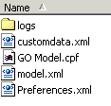
Examine the Project:
A project is a set of models, packages, and related information for maintaining and sharing model information. A single project can span many data sources or tables.
A project appears in a file system as a folder that contains a project file (.cpf) and XML files.
Notes:
This slide helps in knowing and examining a Project created using Framework manager.
Project is a set of models, packages, and related information for maintaining and sharing model information. A single project can span many data sources or tables.
To identify the location of a project , look out for the folder with it’s name same as the name given to the project during creation .
The folder identified would have a project file with a .cpf extension to it ,some XML files and a folder containing logs recording the creation of the project details.
HCU EABIS
Cognos Competency

Slide 7
Examine the Model:
  It is a metadata layer that adds value to a data source in several ways.
  it provides a business view of the information in the source data to report authors and query users to simplify building reports and queries
  A model is the set of related dimensions, query subjects, and other objects required for one or more related reporting applications.
Notes:
Now let’s examine the model after examining the project.
- Model is a metadata layer that adds value to a data source .
- It provides a business view of the information in the source data to report authors and query users to simplify building reports and queries
- It is the set of related dimensions, query subjects, and other objects required for one or more related reporting applications.
HCU EABIS
Cognos Competency

Slide 8
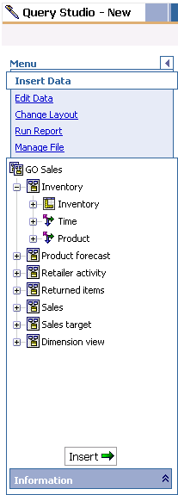

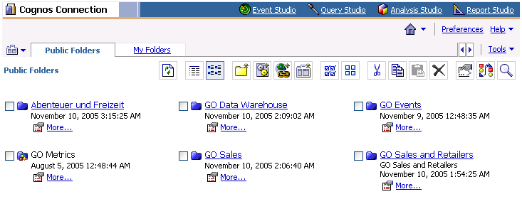
Examine the Model:
Examine the model from the perspective of the report or ad hoc query author.
Notes:
This slide shows how the model so created can be looked from the perspective of a report author via report studio and also from the perspective of an adhoc query author via query studio .
The model created is now available for reporting or adhoc querying for users. The users can simply select from the range of models available to them while generating queries or reports out of it.
HCU EABIS
Cognos Competency

Slide 9
Namespace and Folder:
Namespace:
A namespace uniquely identifies query items, dimensions, query subjects, and other objects. You import different databases into separate namespaces to avoid duplicate names.
Folder:
You can create folders to organize objects by subject or functional area. This makes it easier for you to locate metadata in projects that have many query subjects or dimensions. You can nest folders by creating new folders in an existing folder.
Notes:
Now let’s understand the next set of objects after examining the model.
1)Namespace: It uniquely identifies query items, dimensions, query subjects, and other objects. You import different databases into separate namespaces to avoid duplicate names.
2)Folder: Folders are created to organize objects by subject or functional area. It’s easy to locate metadata in projects that have many query subjects or dimensions.
You can nest new folders too within an existing folder.
HCU EABIS
Cognos Competency

Slide 10
Query Subject:
A query subject is a set of query items that have an inherent relationship. query subjects behave like tables.
Relational Data source query subject
    SQL query that acts as a view into the underlying query data source
    default data source query subjects are created based on imported objects
Model query subject
    contains query items based on other existing objects in the model
Stored procedure query subject
    contains query items based on the return list of a stored procedure
Notes:
3)Query subject: It is a set of query items that have an inherent relationship. There are 3 kinds of Query subjects:
Relational Data source query subject: It’s SQL query that acts as a view into the underlying query data source.
It references data in a single data source . When metadata is first imported, a data source query subject is created by default for each table you
select. Default relationships between query subjects are created for you automatically.
ii) Model Query Subject: It contains query items based on other existing objects in the model. Model query subjects can be enhanced by adding filters or calculations to
create additional query items.
iii) Stored procedure query subject: It contains query items based on the return list of a stored procedure. Stored procedure query subjects cannot be enhanced by filters or calculations.
HCU EABIS
Cognos Competency

Slide 11
Query Item and Relationship:
Query Item:
A query item is the smallest piece of the model that can be placed in a report. Query items are contained in query subjects or dimensions. query items that represent each column in the table.
Relationship:
A relationship describes how to create a relational query for multiple objects, such as dimensions and query subjects. Without relationships, these objects are isolated sets of data.
Notes:
4) Query Item: It is the smallest piece of the model that can be placed in a report. Query items are contained in query subjects. For example, a query subject that references an entire table contains query items that represent each column in the table.
5) Relationship: A relationship describes how to create a relational query for multiple objects, such as dimensions and query subjects. Without relationships, these objects are isolated sets of data.
HCU EABIS
Cognos Competency

Slide 12
Packages:
You create a package to make metadata available to report authors. A package is a subset of a project. It must contain all the information that a specific user or group of users needs to create reports.
A package contains query subjects whose SQL defines the query items and relationships that the package retrieves.
To create and manage packages, you can:
Modify a Package – select, hide, unselect
Specify Languages – what languages will the report authors be able to see
Set Governors – set data retrieval limits
Explore packages– identify what is hidden, selected/unselected in a package
View package inclusion – select an object and identify which package (s) it has been included in
Publish a Package
  publish packages to the Cognos8 server or to a network
  location enable versioning
Notes:
6)Packages:
- You create a package to make metadata available to report authors. A package is a subset of a project. It must contain all the information that a specific user or group of users needs to create reports.
- A package contains query subjects whose SQL defines the query items and relationships that the package retrieves.
- A package is what is actually published to the Cognos Report Net server, and it is used to create
reports and adhoc queries.
- To create and manage packages, you can:
Modify a Package – select, hide, unselect objects in a project based on the requirements of reports authors.
Specify Languages – what languages will the report authors be able to see
Set Governors – set data retrieval limits
Explore packages– identify what is hidden, selected/unselected in a package
View package inclusion – select an object and identify which package (s) it has been included in
- To Publish a Package
publish packages to the Reportnet server or to a network location
enable versioning - you can select how many versions of the model you want to retain on the Cognos ReportNet server.
HCU EABIS
Cognos Competency

Slide 13
Cognos Cognos8 Workflow:
PLAN
MANAGE
MODEL
AUTHOR
CONSUME
Plan for
Implementation
Install
Framework
Manager
Projects
Author
Reports
Run, View,
Print
Reports
Configuration
Publish
Package
Setup &
Maintain
Security
Administer
Servers
& Reports
Notes:
Now that we have familiarized ourselves with the objects , time to know where does modeling sit amidst the list of activities in this road map.
This slide shows us a visual representation of the same.
HCU EABIS
Cognos Competency

Slide 14


Framework Manager Workflow:
Data
Sources
Import
Design/Create
Project
Prepare Metadata
Prepare the Business View
Create and Manage Packages
Manage
Project
Publish
Set
Security
Report Studio
Query Studio
Content
Store
Notes:
This slide shows us the workflow that we adopt to publish a package using Framework Manager:
Import Data sources
Design Or Create a project
Prepare metadata
Prepare the Business View
Create and manage Packages
Set Security
Publish the package
Retrieve the package from the Content Store Database using Report/Query Studio
HCU EABIS
Cognos Competency

Slide 15
Design and Create Project:
Design
  Know your data and the structure of your data sources.
  Work with report authors to understand business reporting requirements.
  Identify project structure.
Create
  Create a project.
  Import the required metadata.
Organize
  Organize objects to create a physical view of the metadata.
Design/Create
Project
Notes:
Now let’s explore each of the steps stated in the previous slide.
To start with, let’s see how do we design and create a project.
Design: The following are the key items to be taken care of while designing a project
- Know your data and the structure of your data sources.
- Work with report authors to understand business reporting requirements.
- Identify project structure.
Create: The following are the key items to be taken care of while creating a project
- Create a project.
- Import the required metadata.
Organize: The following are the key items to be taken care of while organizing a project
- Organize objects to create a physical view of the metadata.
HCU EABIS
Cognos Competency

Slide 16
Prepare Metadata:
Administer
  Specify query processing type.
  Define function sets.
Clean Up
  Examine and modify object properties.
  Examine, modify, and create relationships.
  Edit SQL.
Prepare Metadata
Notes:
Let’s move on to the second step now which is Preparing Metadata
This includes:
Administer: It is responsible for the following
- Specify query processing type.
- Define function sets.
Clean Up: It is responsible for the following
- Examine and modify object properties.
- Examine, modify, and create relationships.
- Edit SQL.
HCU EABIS
Cognos Competency

Slide 17
Prepare the Business View:
To enhance the business view of the model, you can:
  create one or more presentation views
  add calculations
  create and apply filters
  add prompts
  create dynamic queries
  use star schema groupings
  specify dimensional information
Prepare the Business View
Notes:
This slide shows the third step which is Preparing the Business view.
To enhance the business view of the model, you can:
- create one or more presentation views
- add calculations
- create and apply filters
- add prompts
- create dynamic queries
- use star schema groupings
- specify dimensional information
HCU EABIS
Cognos Competency

Slide 18
Create and Manage Packages:
To create and manage packages, you can:
  define the package contents
  modify a package
  specify languages
  set governors
  view package inclusion
  enable versioning
Create and manage
Packages
Notes:
Moving on we now come to the fourth step presented in this slide which is Creating and Managing packages.
To create and manage packages, you can:
- define the package contents
- modify a package
- specify languages
- set governors
- view package inclusion
- enable versioning
HCU EABIS
Cognos Competency

Slide 19
Set Security:
Report Net security is implemented through user authentication and authorized access to content.
To set security in Framework Manager, you can:
  define access to packages
  create security filters
  define access to objects
  define package administration access
Set
Security
Notes:
The next step after we create and manage a package is Setting the Security for the package we created.
Security is implemented through user authentication and authorized access to content.
To set security in Framework Manager, you can:
- define access to packages
- create security filters
- define access to objects
- define package administration access
HCU EABIS
Cognos Competency

Slide 20
Manage Project:
Perform project management activities such as:
  implementing multi-user modeling
    repository control
  sharing and reusing information
    segmenting and linking
  action logging and synchronizing
  checking a project
Manage
Project
Notes:
Once we set the security , we are ready now to start with Management of the project that we created just now.
The project management activities that needs to be performed are:
implementing multi-user modeling: using repository control
sharing and reusing information: segmenting and linking
action logging and synchronizing: checking a project
HCU EABIS
Cognos Competency

Slide 21
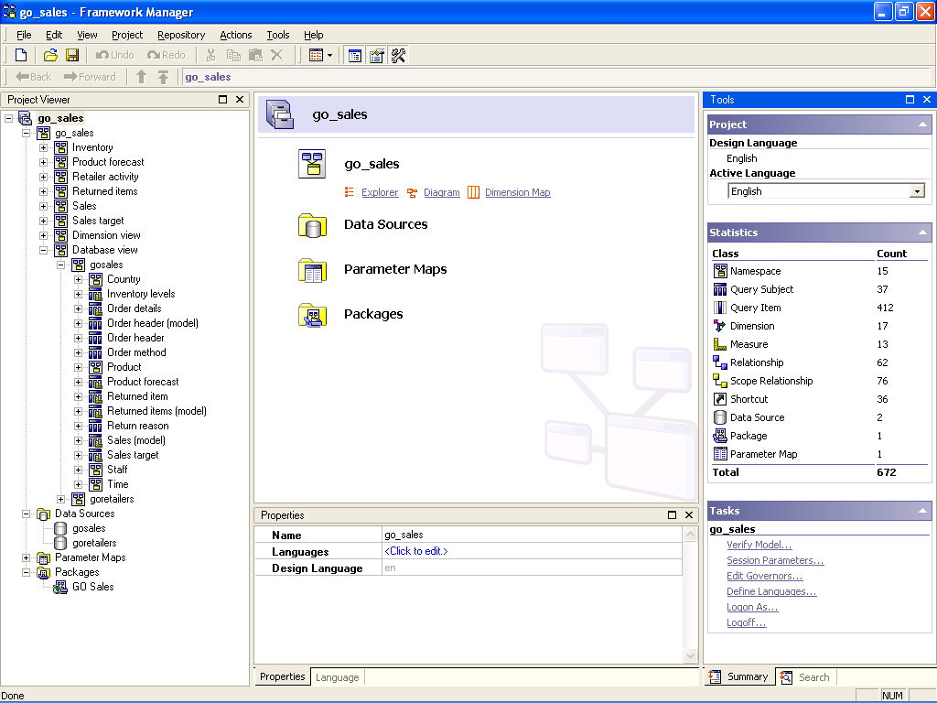
Examine Framework manager GUI:
Project Info
Object Explorer
Object Diagram
Notes:
Once we have examined the steps to start with Framework Manger, now let’s move on to Examine the GUI for Framework Manager.
1)The left pane is the Project Pane containing the list of query subjects, query items that fall under the project considered.
2)Towards the mid, we see the Project Info pane consisting of Object Explorer, Object Diagram and Dimension Map.
3) At the extreme right ,we find the Tasks pane that allows us to edit the settings like editing the governors, specifying language, setting up the session parameters which we already defined during creation of package.
3)The Properties pane towards the bottom shows the Properties for each selected item.
To ease understanding , each of these panes have been highlighted using red rectangular boxes.
HCU EABIS
Cognos Competency

Slide 22
Examine Naming Convention:
Objects in Framework Manager:
  have an identifier
  can have the same name but must be uniquely identified using a namespace
The identifier can consist of one, two, or three parts. For example:
  query items have a three-part identifier
    e.g., [GoSales].[Product].[ProductCode]
  namespaces, functions, shortcuts to namespaces, and shortcuts to folders have a one-part identifier
    e.g., [GoSales]
  all other objects have a two-part identifier
    e.g., query subjects:[GoSales].[Product]
Notes:
Let’s examine the Naming Convention that we usually follow ,in this slide
To name the Objects in Framework Manager, we have an identifier which can have the same name but must be uniquely identified using a namespace
The identifier can consist of one, two, or three parts.
For example:
query items have a three-part identifier
e.g., [Go Sales].[Product].[Product Code]
namespaces, functions, shortcuts to namespaces, and shortcuts to folders have a one-part identifier
e.g., [Go Sales]
all other objects have a two-part identifier
e.g., query subjects:[Go Sales].[Product]
HCU EABIS
Cognos Competency

Slide 23
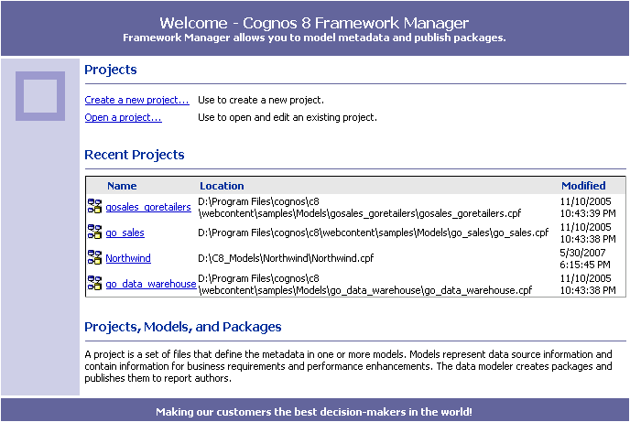
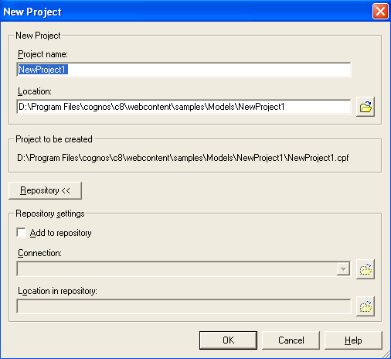
Create a Project:
Specify a name and file location for your project.
Notes:
Now that we have a clear understanding of what a project is all about, let’s go ahead and create one .
The steps that we need to take up for the same are:
1)Open the Framework Manager from Start->Program >Cognos8->Framework Manager
2)Click on Create a New Project
3)Specify a name and a file location for this project
HCU EABIS
Cognos Competency

Slide 24
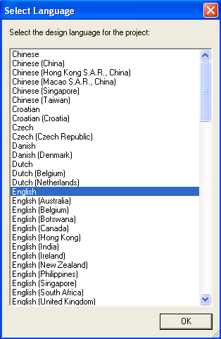
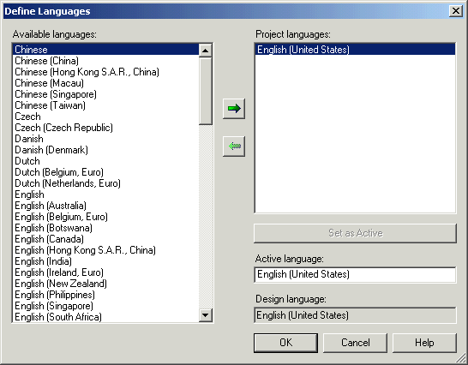
Define Language:
Specify a design language for the project when you first create it.
Add languages any time after the project is created.
Notes:
4) Now define a language for the project . Let’s say we select English as a language for this project for now.
You might add languages any time after the project is created.
HCU EABIS
Cognos Competency

Slide 25
Examine Data Sources:
Import metadata into the model from the following sources:
  relational databases
  existing Cognos Cognos8 models
  Architect models
  Impromptu catalogs
  Cognos DecisionStream
  Cognos 8 Data Manager
  third-party metadata sources
Notes:
5)Import metadata from the existing datasources mapped using Cognos Connection
The sources from where we could import may be any of the following:
- relational databases
- existing Cognos Report Net models
- Architect models
- Impromptu catalogs
- Cognos DecisionStream
- Cognos 8 Data Manager
- third-party metadata sources
HCU EABIS
Cognos Competency

Slide 26
Import from multiple Data sources:
Import metadata from one or more of the supported data sources.
Consider the following:
  Create a separate namespace for each import.
  Define relationships between query subjects.
  Create model query subjects that contain query items from two or more data source (or model) query subjects.
Notes:
6) In case we need to import metadata from multiple data sources you would need to consider the following:
- Create a separate namespace for each import.
- Define relationships between query subjects.
- Create model query subjects that contain query items from two or more data source (or model) query subjects.
HCU EABIS
Cognos Competency

Slide 27
Import Metadata:
Import metadata from a relational database.
Select Object for
Import
Select Data
Source
Select Objects to Import
Select Criteria to Generate
Relationships
Select Import
Source
Create Data
Source
Import
Notes:
To import metadata from a relational database following are the steps to be followed:
1)Select object for Import
2)Select Import Source
3)Select data source. Create a new data source if we don’t have one already existing.
4)Select objects to import
5)Select criteria to generate relationships
6)Finally Import
HCU EABIS
Cognos Competency

Slide 28
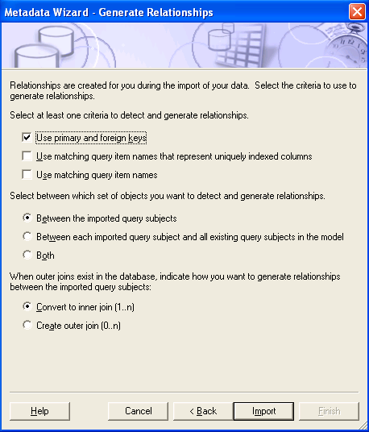
Specify Relationship Criteria:
Select Criteria to Generate Relationships
Notes:
This slide shows the Metadata wizard .This slide presents the Criteria used to Detect and Generate Relationships.
The steps detailed here are:
1)Select at least one criteria to detect and generate relationships
Use primary and foreign keys
Use matching query item names that represent uniquely indexed columns
Use matching query item names
2)Select between which set of objects you want to detect and generate relationships
Between the imported query subjects
Between each imported query subject and existing query subjects in the model
Both of the above
3)When outer join exists in the database, indicate how you want to generate relationships between the imported query subjects
Convert to inner join
Convert to outer join
HCU EABIS
Cognos Competency

Slide 29
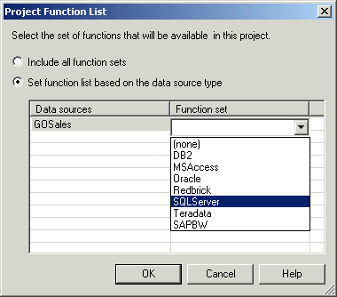
Define Function Sets:
You can restrict the function sets available in the expression editor so that it lists only the vendors that you want.
Notes:
The next step presented here is Defining Function Sets.
You can restrict the function sets available in the expression editor so that it lists only the vendors that you want.
HCU EABIS
Cognos Competency

Slide 30
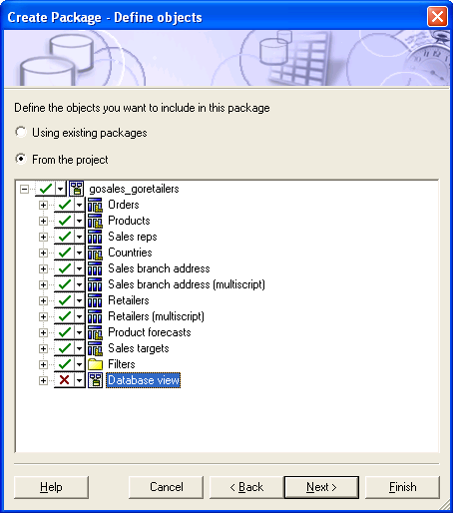
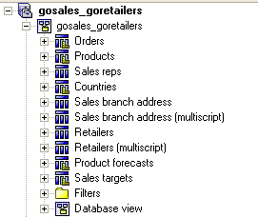
Create and Modify Packages:
Include the model objects you want to publish in your package.
Notes:
Now let’s include the model objects that you need to publish in your package by checking or unchecking the items available.
HCU EABIS
Cognos Competency

Slide 31
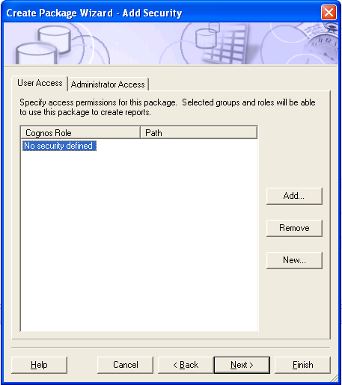
Specify Package Security:
Notes:
Now let’s specify security or authentication required to access the package to be created by adding users/groups with appropriate access rights to each of the users or groups.
HCU EABIS
Cognos Competency

Slide 32
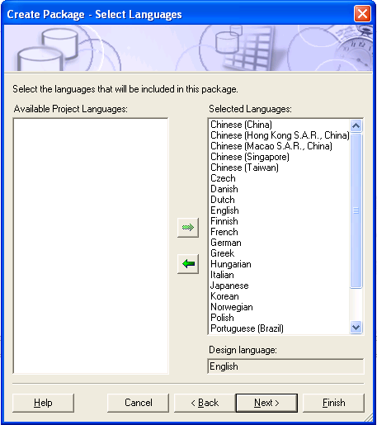
Specify Package Language:
In the instance of multilingual data you must specify the languages to be published with a package.
You must add languages to the project before you can add them to a package.
Notes:
In the instance of multilingual data presented at reporting side, you must specify the languages to be published with a package.
You must add the required languages to the project before you can add them to a package.
HCU EABIS
Cognos Competency

Slide 33
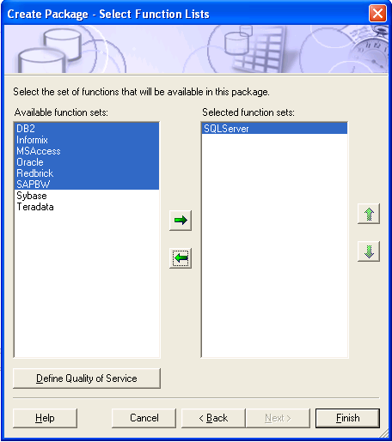
Specify Package Function List:
The package function list is used to specify which data source functions you would like to make available to report authors.
Notes:
Specify Package Function
The package function list is used to specify which data source functions you would like to make available to report authors.
HCU EABIS
Cognos Competency

Slide 34
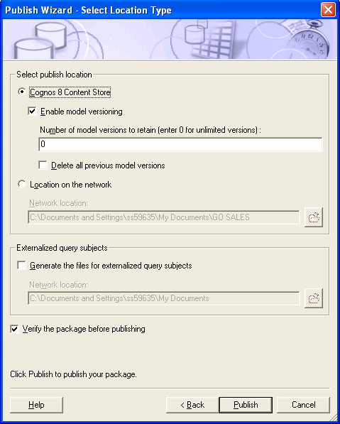
Publish Packages:
When you publish a package, you can choose to save either to the Cognos8 server or to a network location.
Before publishing, you should verify the package.
Cognos Connection
File System
Notes:
Now it’s time to publish the package created. This would be the final step in this process of creating a package.
When you publish a package, you can choose to save either to the Report Net server or to a network location.
Before publishing, you should verify the package.
HCU EABIS
Cognos Competency

Slide 35
Dimensional Modeling of Relational Data Sources:
A relational data source should be dimensionally modeled when you want to do one or more of the following:
  Use Analysis Studio
  Enable drill functionality in reports
  Access member functions in the report authoring tools

Slide 36
Using dimensional concepts:
Following are the steps to create dimensional model in FM
  Create a regular dimension for groups of query subjects that have hierarchical relationships representing a single business concept.
  Create a measure dimension for groups of query subjects that have factual data sharing many regular dimensions or having a master-detail type of relationship.
  Use the cardinality rules to identify areas of the model where the role of an object as fact or dimension is not clear.
Notes:
The result of simplifying the model should be a layer of regular and measure dimensions that clearly represent the data in terms of business concepts and ensure predictable query generation.
HCU EABIS
Cognos Competency

Slide 37
Creating a Regular Dimension
Contains descriptive and business key information that provides context for data modeled in measure dimensions.
Organizes the information in a hierarchy from the highest level of granularity to the lowest.
It has multiple levels and may have multiple key segments to define a level.
It may also have multiple hierarchies.
Can use only one hierarchy at a time in a query.
To use two hierarchies in the same report, create two dimensions, one for each hierarchy.
Is broken into groups of information called levels.
Notes:
HCU EABIS
Cognos Competency

Slide 38
Measure Dimension:
A collection of facts.
Can be created for one or more query subjects that have a valid relationship between them.
Represent the quantitative data described by regular dimensions.
Differ from fact query subjects
  They do not include the foreign keys used to join a fact query subject to a dimensional query subject.
Cognos Competency integration * intelligence * insight

Slide 39
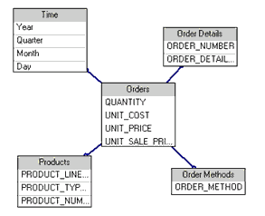
Creating Measure Dimension:
To simplify the model in this example, create a model query subject that combines the foreign keys of both Order Header and Order Details and includes all measures at the Order Detail level. Then create a measure dimension based on the model query subject.
Notes:
Another example to present Creation of Measure Dimension is presented here.
In this case, create a model query subject that combines the foreign keys of both Order Header and Order Details and includes all measures at the Order Detail level. Then create a measure dimension based on the model query subject.
HCU EABIS
Cognos Competency

Slide 40
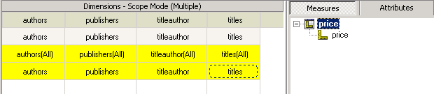
Scope Relationship:
Exist between measure dimensions and regular dimensions.
Defines the level at which the measures are available for reporting.
Govern the reporting granularity of the regular dimension for a particular measure dimension.
Not the same as joins and do not impact the Where clause.
Shortcuts cannot be created for scope relationships.
Notes:
When shortcuts to dimensions are used, the scope is derived from the scope of the target objects unless scope has been explicitly defined on the shortcuts.
HCU EABIS
Cognos Competency

Slide 41
Dimension Information:
In Cognos 8, the concept of dimension information is divided between determinants and hierarchies for regular dimensions.
Determinants :
  control uniqueness and granularity.
  defines the set of database columns (query items) that uniquely identify a set of data.
  can identify a set of columns that identify a non-unique set within the data
Hierarchies :
  for regular dimensions explicitly address dimensional concepts of hierarchies, levels, keys, and attributes for all data sources.

Slide 42
Determinants :
Control uniqueness and granularity
  This control is required for relational query subjects
Can define the set of database columns (query items) that uniquely identify a set of data, or it can identify a set of columns that identify a non-unique set within the data.
If a model regular dimension is based on a query subject with determinants specified, it is recommend that
  one level correspond to each determinant that exists in the query subject
  the order of the levels in the hierarchy reflect the order of the determinants
Notes:
This results in a consistent model, facilitating upgrading the model in future releases of Cognos products.

Slide 43
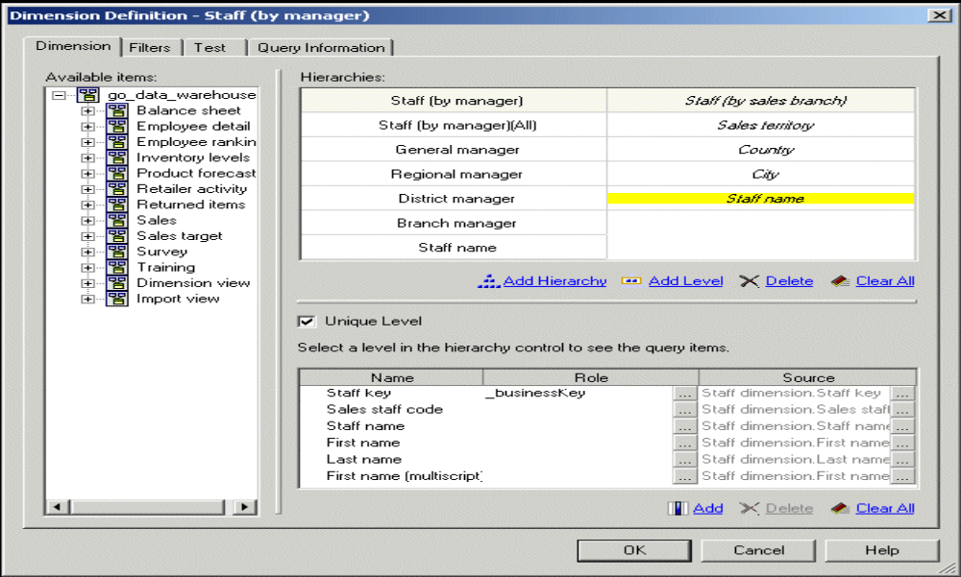
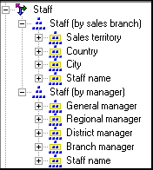
Hierarchies :
A hierarchy is an ordered list of levels or a collection of items
Multiple hierarchies occur when different structural views can be applied to the same data
For example, sales staff can be viewed by manager or geography
Staff is a single dimension with two hierarchies:

Slide 44
Conformed Dimension
A dimension, with a single definition, that is reused or shared across multiple data subject areas.
Physically, these subject areas can include multiple cubes or multiple relational star schemas.
Provide a useful design approach for dimensions that are widely used throughout the enterprise, for example Product or Time.
This is because common definitions for common dimensions allow data from different subject areas to be meaningfully compared and used in calculations and drill through from one area to another

Slide 45
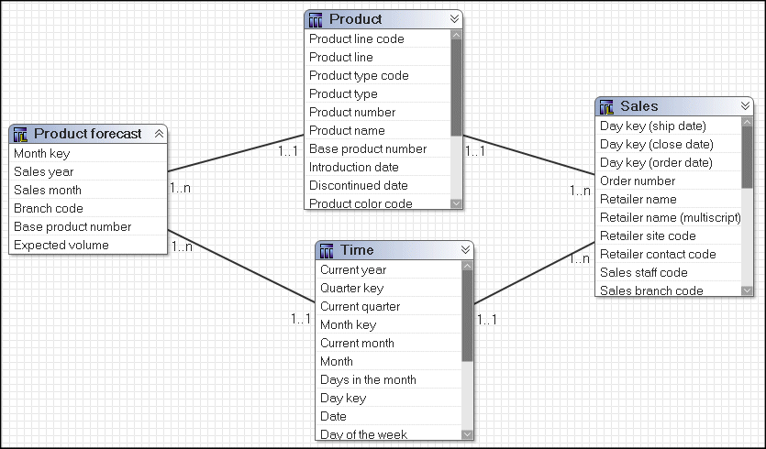
SQL Generated Query on Conformed Dimensions:
A query on multiple facts and conformed dimensions respects the cardinality between each fact table and its dimensions
Writes SQL to return all the rows from each fact table.
Fact tables are matched on their common keys, and are aggregated to the lowest common level of granularity.
Nulls are often returned for this type of query because a combination of dimensional elements in one fact table may not exist in the other.

Slide 46
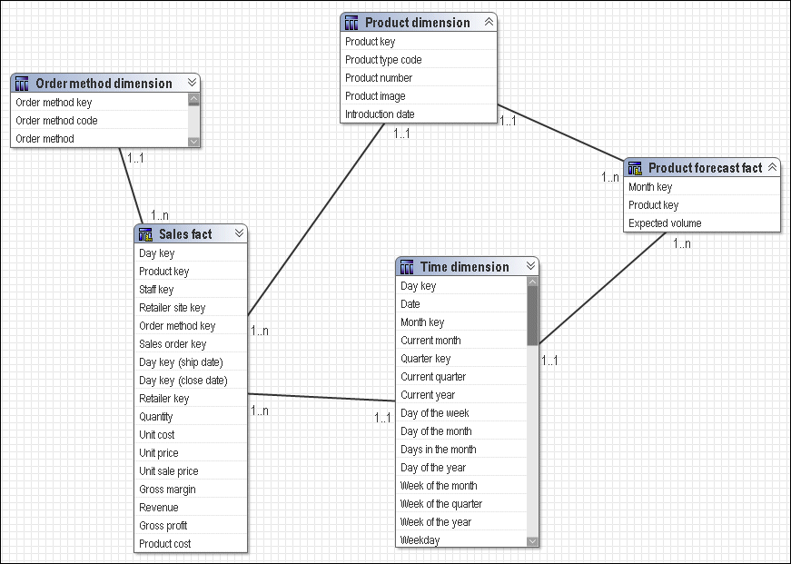
SQL Generated Query on Non-Conformed Dimensions:
In Non-conformed dimension it is not possible to aggregate records to a lowest common level of granularity
One side of the query has dimensionality that is not common to the other side of the query.
Result returned is two correlated lists, which are related to each other only through the shared dimensional information.
Cognos Competencyintegration * intelligence * insight

Slide 47
Resolve ambiguous relationships:
Ambiguous relationships occur when the data represented by a query subject or dimension can be viewed in more than one context or role.
The most common ambiguous relationships are:
      multiple valid relationships
      recursive relationships
You can resolve ambiguous relationships in Framework Manager, or the database administrator can fix them in the data source.
For example, the database administrator can remove extra relationships, although this may not be practical.
Resolving ambiguous relationships in the model involves determining which query path to use.
Notes:
HCU EABIS
Cognos Competency

Slide 48
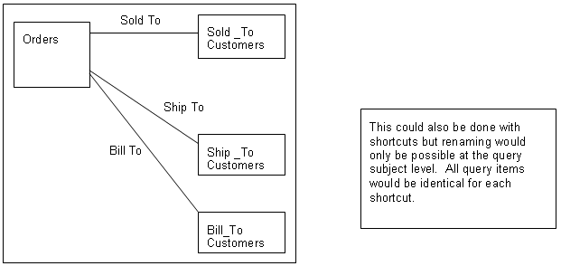

Resolve ambiguous relationships:
Resolving multiple valid relationships
A table that has multiple valid relationships between itself and another table is
known as a role-playing dimension
Notes:
A good example is an Orders fact, which may have multiple relationships to the Customer dimension on keys such as sold_to, ship_to and bill_to.
HCU EABIS
Cognos Competency

Slide 49
Resolve ambiguous relationships:
Recursive relationships
Employee Query Subject
Employee ID
Manager ID
Phone Number
Ext.
…
Recursive Relationship
Between Employee ID
and
Manager ID
Employee Query Subject
Employee ID
Manager ID
Phone Number
Ext.
…
Shortcut to Employee Query Subject
Employee ID
Manager ID
Phone Number
Ext.
…
1..1
1..n
Recursive Relationship
Can now be edited
Notes:
Recursive relationships which is another example of Ambiguous Relationships can be resolved now .
This slide presents a way by means of which no more recursive relationships would exist in the model you create.
An example presented here is an Employee Query subject / table which holds recursive relationship between it’s query items Employee ID and Manager ID where every Manager ID could be a Employee ID as well is now resolved by creating a Shortcut to the Employee Query Subject by defining a 1:n relationship between them.
HCU EABIS
Cognos Competency

Slide 50
Thank you

